Slide 1
Service cancellation predictor

Slide 2
Customers Dataset
Description:
Service cancellation is simply when customers leave doing business with an entity. It involves determining the possibility of customers stopping doing business with an entity. In other words, if a consumer has purchased a subscription to a particular service, we must determine the likelihood that the customer would leave or cancel the membership. It is a critical prediction for many businesses because acquiring new clients often costs more than retaining existing ones. For many businesses, the ability to predict that a particular customer is at a high risk of canceling service, while there is still time to do something about it. Whereas the company will try to offer some extra functionalities for not leaving the service.

Slide 3
Customers Dataset
Dataset description:
The dataset consists of 7043 rows and 21 columns, where rows represent the number of customers in the dataset and the columns represent each customer’s attribute. The attributes are used to predict the service cancellation of a particular customer.
Each row represents a customer, each column contains customer’s attributes described on the column Metadata.
There are 21 columns so we will divide them into independent and dependent columns:-
1- Independent variables: [ ‘customerID’, ‘gender’, ‘SeniorCitizen’, ‘Partner’, ‘Dependents’, ‘tenure’, ‘PhoneService’, ‘MultipleLines’, ‘InternetService’, ‘OnlineSecurity’, ‘OnlineBackup’, ‘DeviceProtection’, ‘TechSupport’, ‘StreamingTV’, ‘StreamingMovies’, ‘Contract’, ‘PaperlessBilling’, ‘PaymentMethod’, ‘MonthlyCharges’, ‘TotalCharges’ ]

Slide 4
Cont.
a. Services that each customer has signed up for – phone, multiple lines, internet, online security, online backup, device protection, tech support, and streaming TV and movies
b. Customer account information – how long they’ve been a customer, contract, payment method, paperless billing, monthly charges, and total charges
c. Demographic info about customers – gender, age range, and if they have partners and dependents
2- Dependent variables: [ ‘Churn’ ]
a. Customers who left within the last month – the column is called Churn

Slide 5
Analysis Steps
Preprocessing
Visualizations
Statistics
Feature Selection
Models

Slide 6
Preprocessing
Handle Nulls
Handle unique and constant columns
Handle duplicate
Handle outliers
Encode (convert non-numeric data to numeric)
Scale (make numeric data in the same ranges)

Slide 7
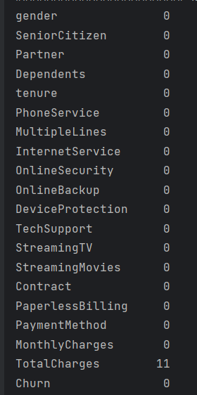
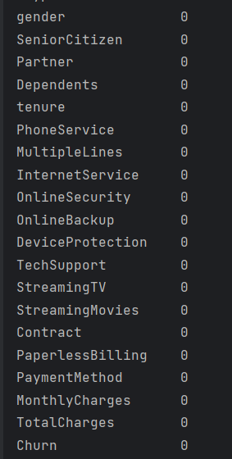
Handle Nulls
First I checked there is null values or not then I found 11 null values in TotalCharges columns so I deleted it because I have 7043 records and it will has no effect

Slide 8
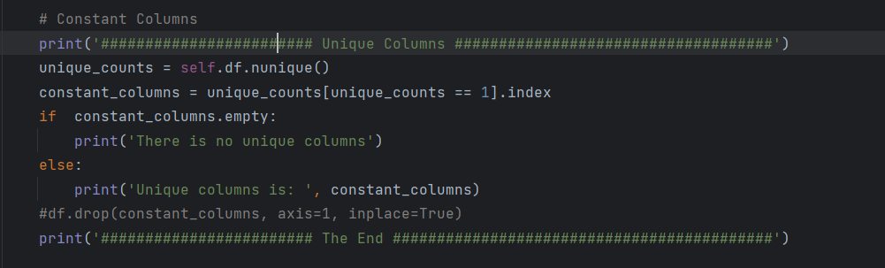

Handle unique and constant columns
First we deleted CustomersID columns because it’s a unique column

Slide 9
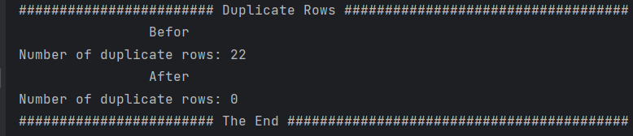
Handle Duplicate
I found 22 duplicated rows so I removed it but it didn’t appear untile I deleted the CustomerID column because the ID is unique in each record.

Slide 10
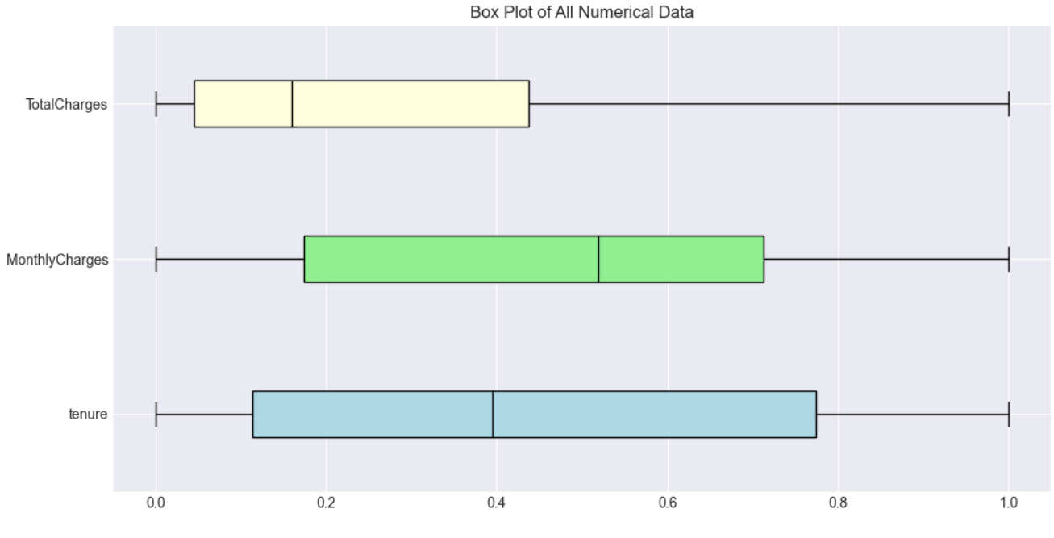
Outliers
From this graph I found that there’s no outliers so I’m not in need to handle outliers.

Slide 11
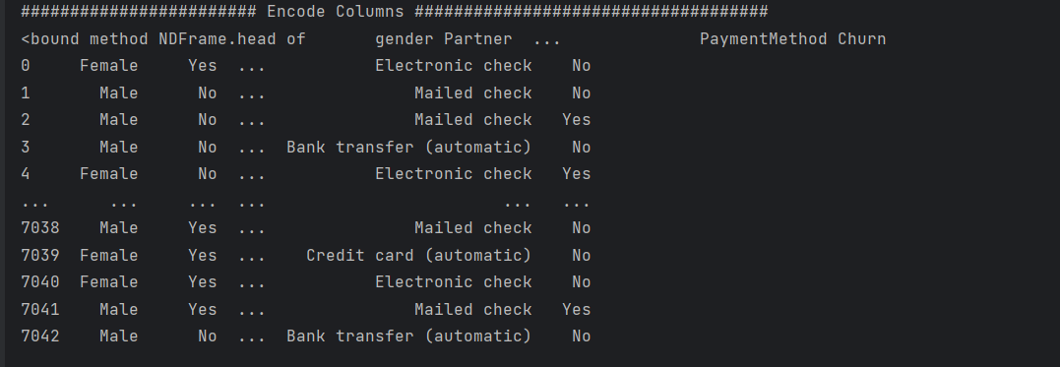
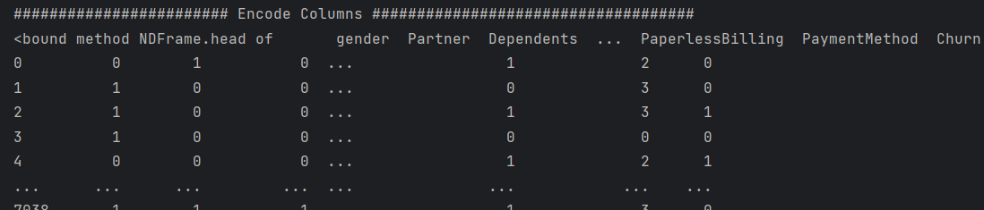
Encode
In my dataset I have a lot of non-numeric data so I had to convert it to numeric to make it easy to train models on

Slide 12
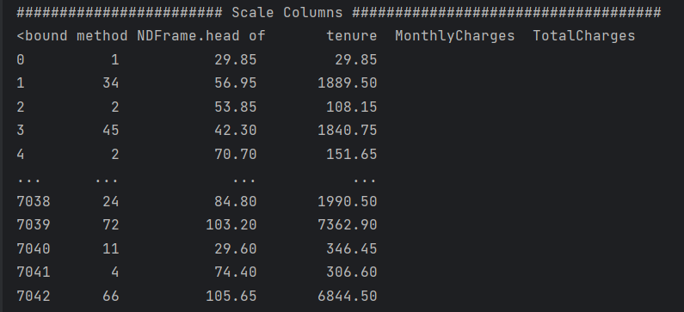
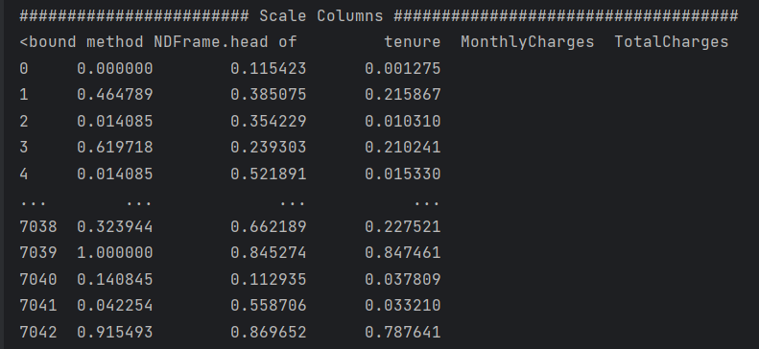
Scale
In my data I have many different ranges so I had to scale it (make it in the same range).

Slide 13
Visualization
I had to do some Visualization to understand my data well so I did it
Bar chart
Histogram
Heat map
Boxblot

Slide 14
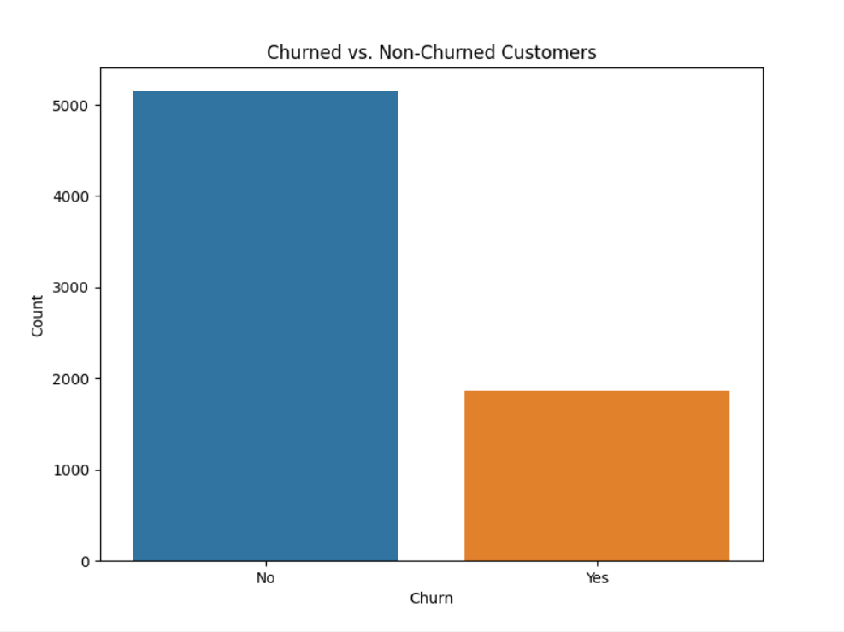
Bar chart
I knew from this there is (no) more than (yes) in Bar chart

Slide 15
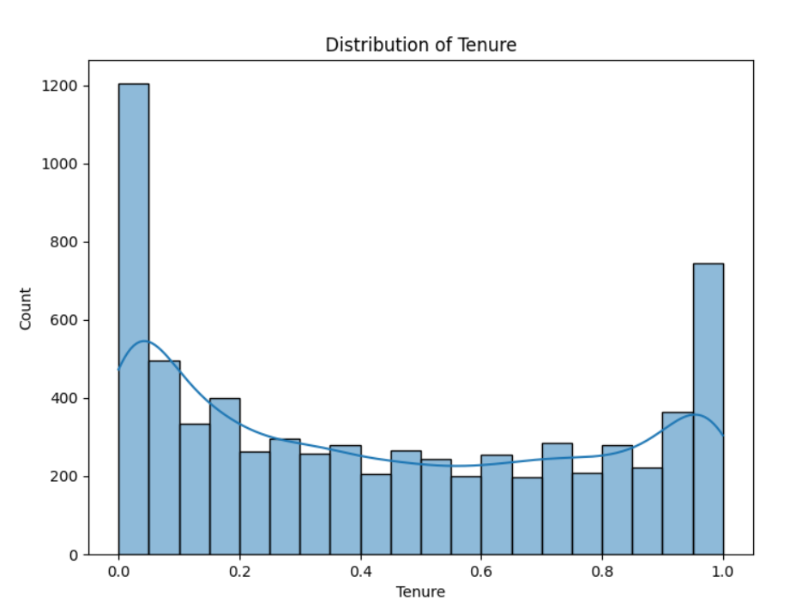
Histogram
I knew from this graph the distribution of
the Tenure column.

Slide 16
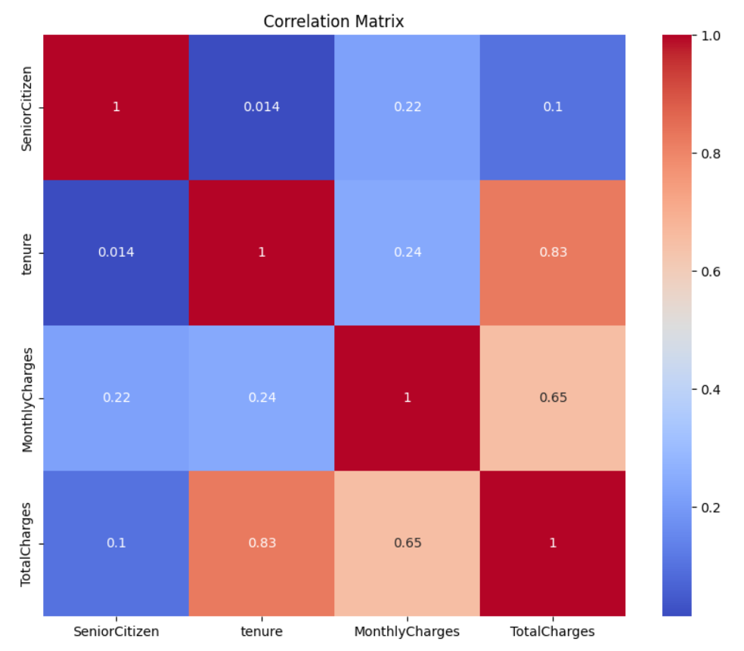
Heat map
I knew from this graph the correlation matrix

Slide 17
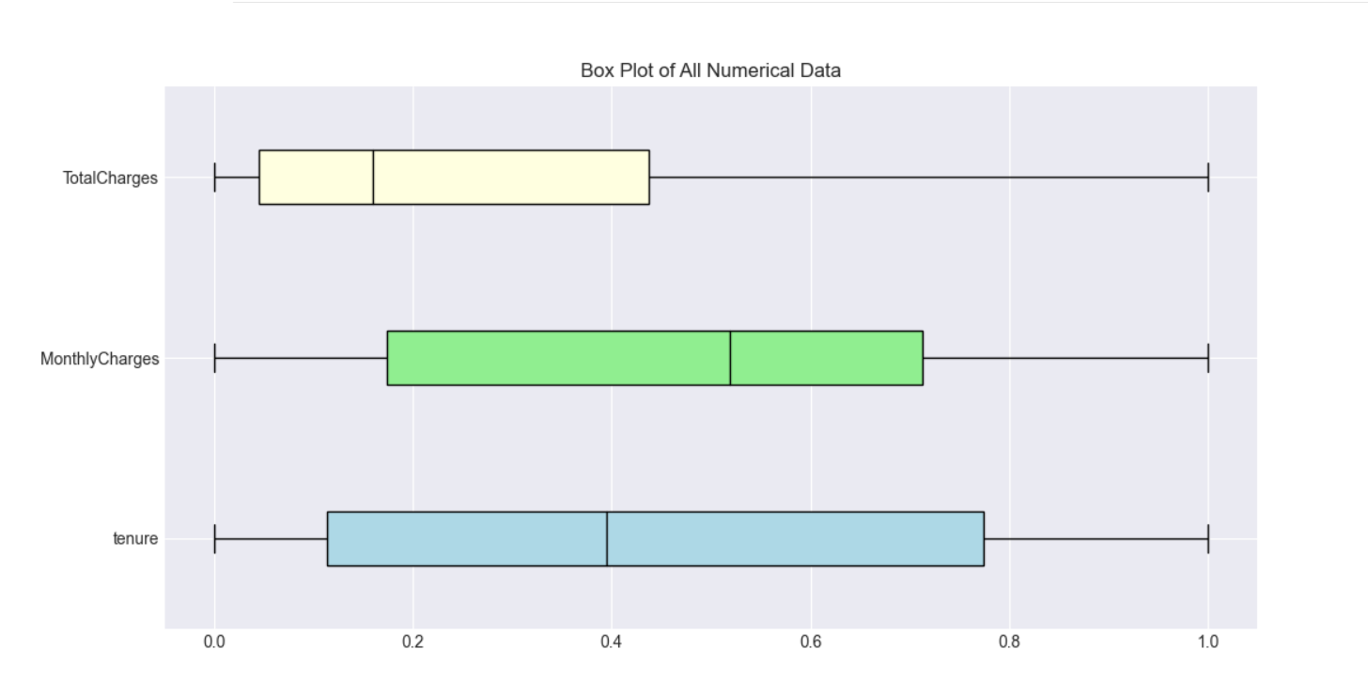
Boxplot
I knew from this graph there is
Outliers or no in my numerical data

Slide 18
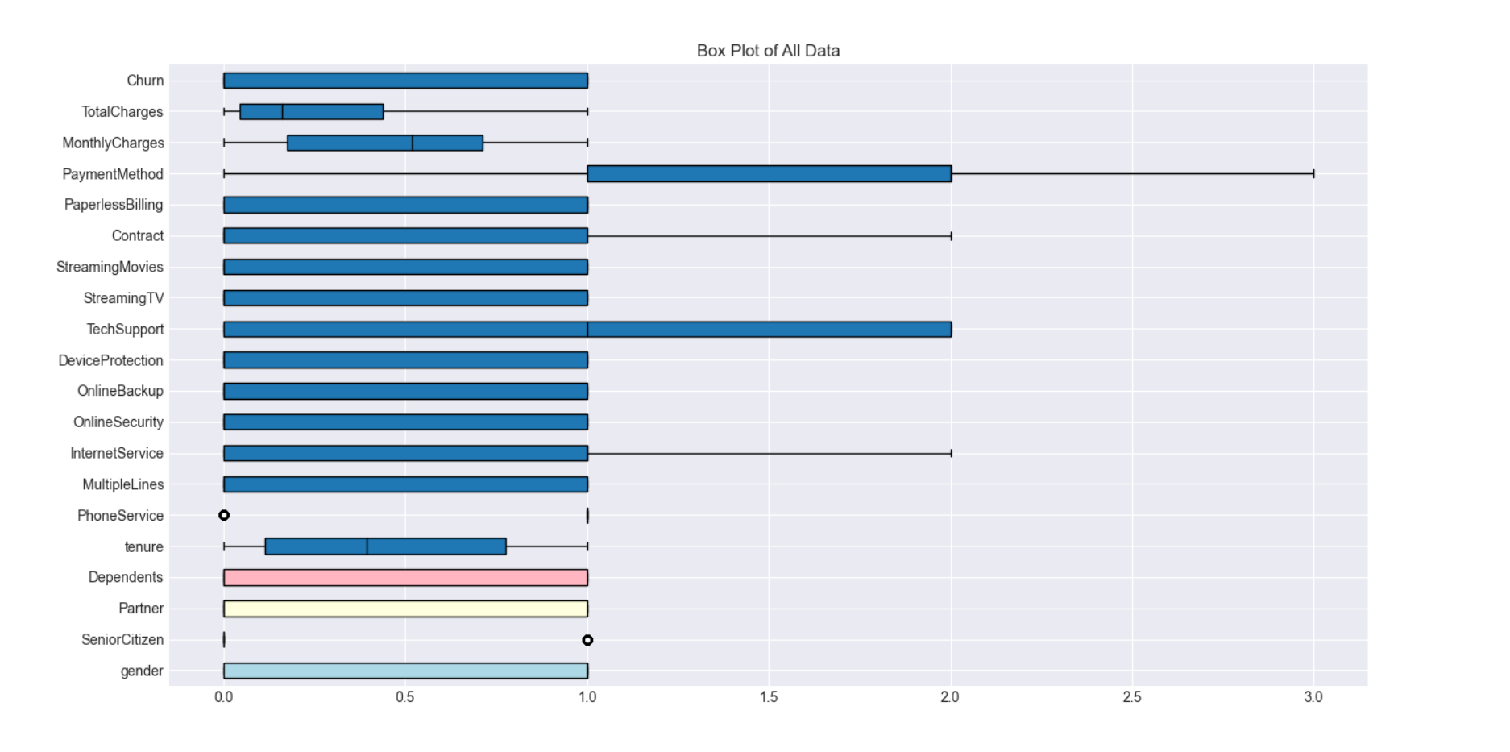
Boxplot Cont.
I knew form this graph every column distribution.

Slide 19
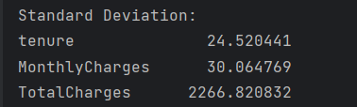
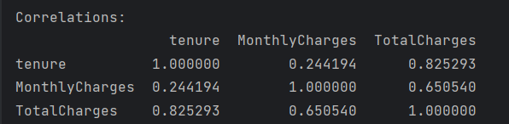
Statistics
I made some Statistics in my data like Standard division and correlation.

Slide 20
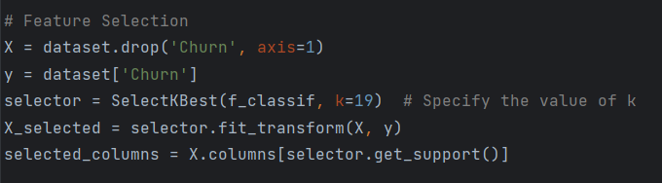
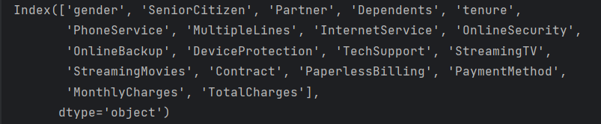
Feature Selection
I went to know the best columns to use it in models training so I used feature selection

Slide 21
Models
That’s the step where we split data into train and test and start training our model in train data then test the model in test dataset and calculate the accuracy to ensure there is no over/under fitting in our model prediction

Slide 22
RandomForestClassifier
The RandomForestClassifier: is a popular machine learning algorithm for classification tasks. It is part of the ensemble learning methods and combines multiple decision trees to make predictions. Each decision tree in the random forest is trained on a random subset of the data and features, and the final prediction is made by aggregating the predictions of individual trees.

Slide 23

KNeighborsClassifier
The KNeighborsClassifier: is a machine learning algorithm used for classification tasks. It is a type of instance-based learning, where the algorithm makes predictions based on the similarity of new data points to the training data.

Slide 24
GradientBoostingClassifier
The GradientBoostingClassifier: is a machine learning algorithm that belongs to the ensemble learning family. It uses a combination of weak prediction models, typically decision trees, to create a strong predictive model. The algorithm builds the models in a sequential manner, where each new model is trained to correct the mistakes made by the previous models.

Slide 25
DecisionTreeClassifier
The DecisionTreeClassifier: is a machine learning algorithm that belongs to the family of decision tree-based models. It creates a tree-like model of decisions and their possible consequences based on the features of the data. Each internal node represents a feature, each branch represents a decision based on that feature, and each leaf node represents a class label or outcome.

Slide 26

LogisticRegression
LogisticRegression: is a popular machine learning algorithm used for binary classification tasks. It is based on the logistic function and estimates the probabilities of the binary outcome. The algorithm learns a linear relationship between the features and the log-odds of the target variable, which is then transformed into probabilities using the logistic function.

Slide 27

SVM
SVM (Support Vector Machine): is a popular machine learning algorithm used for both binary and multi-class classification tasks. It is based on the concept of support vectors, which are the data points closest to the decision boundary of the classifier.

Slide 28
LGBMClassifier
LGBMClassifier: is a classifier based on the LightGBM (Light Gradient Boosting Machine) algorithm. LightGBM is a gradient boosting framework that uses tree-based learning algorithms and is known for its efficiency and accuracy.

Slide 29
GaussianNB
GaussianNB is a classifier based on the Naive Bayes algorithm, specifically designed for classification tasks with continuous (numeric) input features. It assumes that the features follow a Gaussian (normal) distribution.

Slide 30
AdaBoostClassifier
AdaBoostClassifier is a classifier that uses the AdaBoost (Adaptive Boosting) algorithm. AdaBoost is an ensemble learning method that combines multiple weak classifiers to build a strong classifier. It works by iteratively training weak classifiers on different subsets of the training data, assigning higher weights to misclassified samples in each iteration to focus on the difficult cases.

